Slide 1
Azure
(Azure Admin & Azure DevOps)

Slide 2
Agenda
Client Server Architecture
Hosting and different ways of hosting
Cloud Computing
Virtualization
Cloud Service Models
Azure Portal

Slide 3
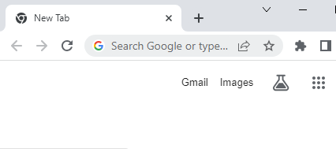
Client Server Architecture
Network
Web Server
website
page1
page2
page3
Client
Server
Client - Which request a resource
Server - Which respond to that resource
Browser – Used to send request
Web server – Used receive request from the client and send response to the client

Slide 4
Types of Client Server Architecture
2 tier Architecture
3 tier Architecture

Slide 5

2-Tier Architecture
Client Layer
Server Layer
Client
Client
Application
Database
Client
Server
Client
Disadvantages
- If more requests come then performance will be slow
- Security issue

Slide 6
3-Tier Architecture
Client Layer
Application Layer
Database Layer
Client
Client
Database
Application
Client
Application Server
Database Server
Client
The server which has application hosted is called Application server.
The server which has database installed is called Database server.

Slide 7
Hosting
The process of publishing your website on the internet is called hosting.
There are different ways of hosting:
In-house hosting
Hosting provider
Cloud

Slide 8
In-House Hosting
high-end server grade machine
high speed internet connection is required
We need 24X7 power backup
Need a dedicated room with air-conditioned
Advantages
Very secure
Disadvantage
Very costly

Slide 9
Hosting Provider
A hosting provider provides infrastructure for hosing an application.
Physical Server
Disadvantage
Wastage of memory
.war
We will not get computing resources based on our requirement. It is not business friendly.
Tomcat
Java
OS
512GB RAM
1000GB Disk
32 CPU

Slide 10
Cloud Computing
The process of giving computing resources on demand is called cloud computing.
Computing resources:
Computer, CPU, RAM, Hard disk, Etc
The people who are providing computing resources are called cloud provider.
The place from where they are proving computing resources is called cloud.

Slide 11
Advantages of Cloud Computing
Improve Productivity
Very Cost Effective
Powerful Server Capabilities

Slide 12
Virtualization
The process of creating multiple virtual machines on a computer is called virtualization.
.war
Tomcat
Java
OS
.war
Tomcat
Java
OS
.war
Tomcat
Java
OS
20 GB RAM
100 GB Disk
10 CPU
30 GB RAM
200 GB Disk
20 CPU
20 GB RAM
100 GB Disk
10 CPU
VM1
VM2
VM3
Hypervisor
(Virtual box, VMware ..)
OS
(Host OS)
512GB RAM
1000GB Disk
32 CPU
- Efficient Resource Utilization
- More Secure

Slide 13
Cloud Models
Infrastructure as a Service (IAAS)
Platform as a Service (PAAS)
Software as a Service (SAAS)

Slide 14
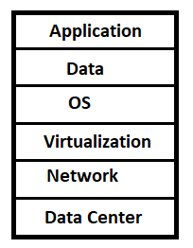
Infrastructure as a Service (IAAS)
Provider is responsible for data center, network and virtualization.
Customer’s is responsible for OS, data and application.

Slide 15
Platform as a Service (PAAS)
Provider is responsible for data center, network virtualization and OS.
Customer’s is responsible for data and application.

Slide 16
Software as a Service (SAAS)
Provider is responsible for data center, network virtualization OS, data and application.
Example:
- Outlook
- Office365
- etc

Slide 17
Azure Portal
Azure portal is a web based interface to access and manage Azure services.
Azure Portal: https://portal.azure.com/

Slide 18
Questions
What is cloud computing?
What are the benefits of cloud computing?
What is a cloud?
What are the different service models in cloud computing?
What do you mean by infrastructure as a service?
What do you mean by platform as a service?
What do you mean by software as a service?
What is virtualization?
What are the benefits of virtualization?
What is client server architecture? Explain different types of client server architecture?

